Slide 1
Selective Web Content Streaming
Demo using Facebook “Likes” Monitor

Slide 2
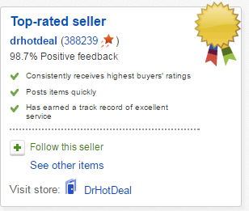
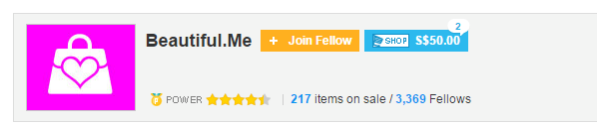
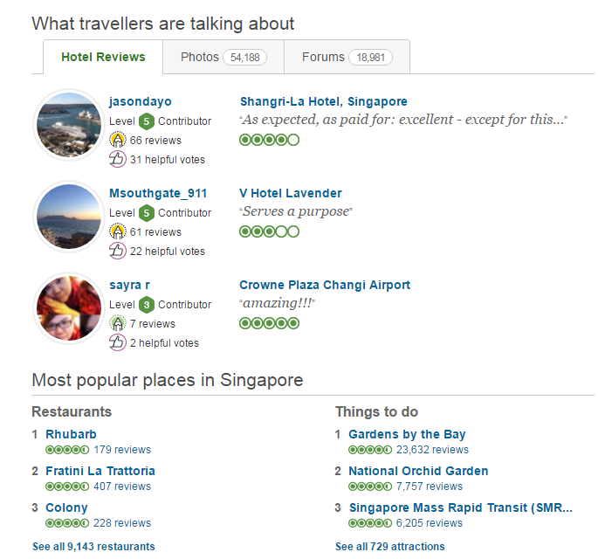
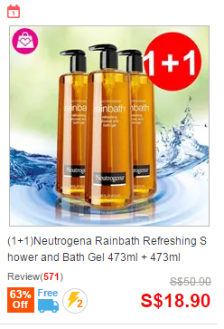
Why Online shopping is more popular…
We use Collective Intelligence

Slide 3
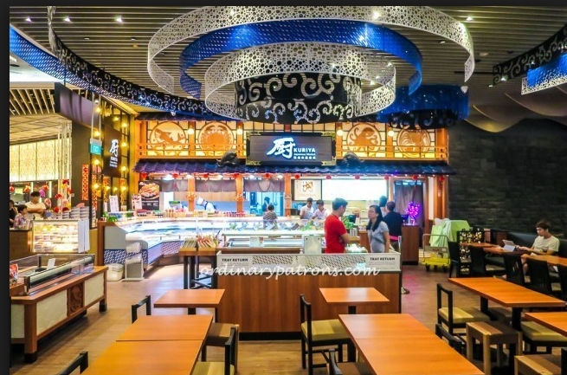
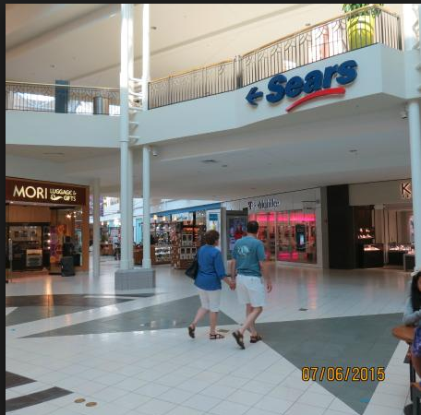
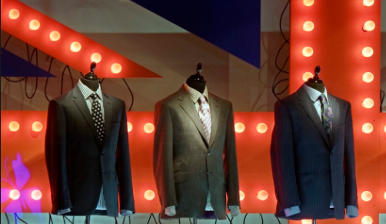
E-Commerce vs Retail:
Can make right judgement based on endorsement of like minded people.
Can review Ratings of products displayed
Can take decision based on Collective intelligence of crowd.
How will be food quality of this restaurant?
Is it popular?
Is this brand popular and sold in Singapore?

Slide 4
Voice of the Customer:
Selective web content streaming will help to trigger more eye balls towards my shop
Though our shop is small in Orchard, it has more people watching/talking in online /social media. I can capitalize the same by having this product.
Displaying our strong presence in Facebook/Twitter will create more interest for people and create more “Buzz”.
iPhix Asia Orchard Plaza- m

Slide 5
Market Size:
All retail shops with Online presence can use this product. (Facebook pages, e-Bay channel, Amazon channel, Restaurant listing).
225+ Malls in Singapore. Average of 150+ shops in each mall. Atleast 30% shops are retail chains.
20% % of the shops can use this to display product reviews. (E.g Branded goods seller, Electronic shops, White consumer goods seller) This could be used for displaying Product reviews inside the shop. So multiple Web content streaming shops inside each shop
School, Education /Learning institute also can use this.
Even if 1% shops use for displaying product reviews, it can sell 10000 pieces easily in Singapore.
Similar problem is faced by retail shops all over the world
Our proposed product is below 99SGD

Slide 6
Value Proposition:
If we build, will they come ? Yes ☺
Retail offers values to customer like Feel, touch, sense, smell. If we add collective intelligence of e-Commerce to retail it will attract more visitors to retail.
Experiment the crowd sourcing for hardware product in SG
Maker mentality / Backer culture/ Creative fulfillment for IoT
Fun and Functional and (trying)to be unique in design /power efficient to showcase of DIY type IoT product

Slide 7
Validation:
A product of cyber physical system / physical computing
The “Likes” = virtual sensor
On the shoulder of Gaint( Facebook, Twitter)
On Kickstarter style – 100 orders first -Validate “this” idea in Singapore ( Fun, Functional, Hardware also sellable )

Slide 8
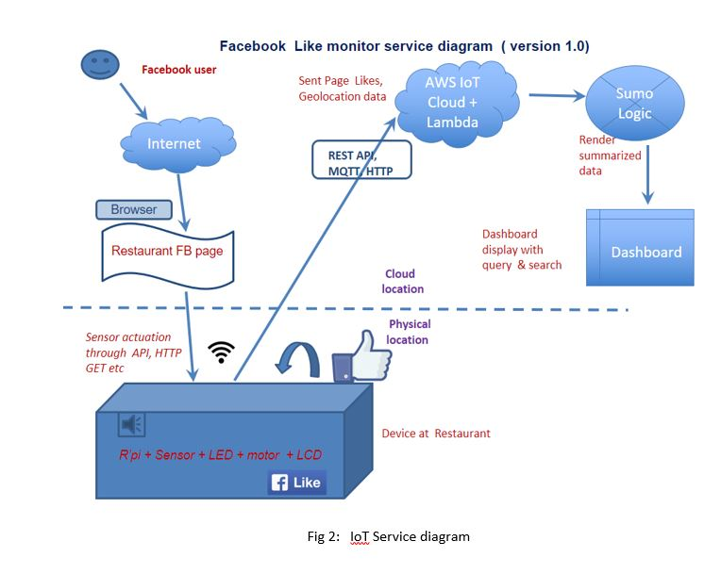
Architecture Diagram:

Slide 9
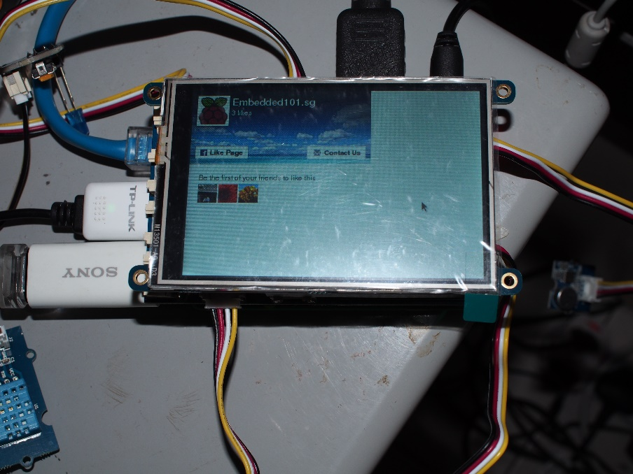
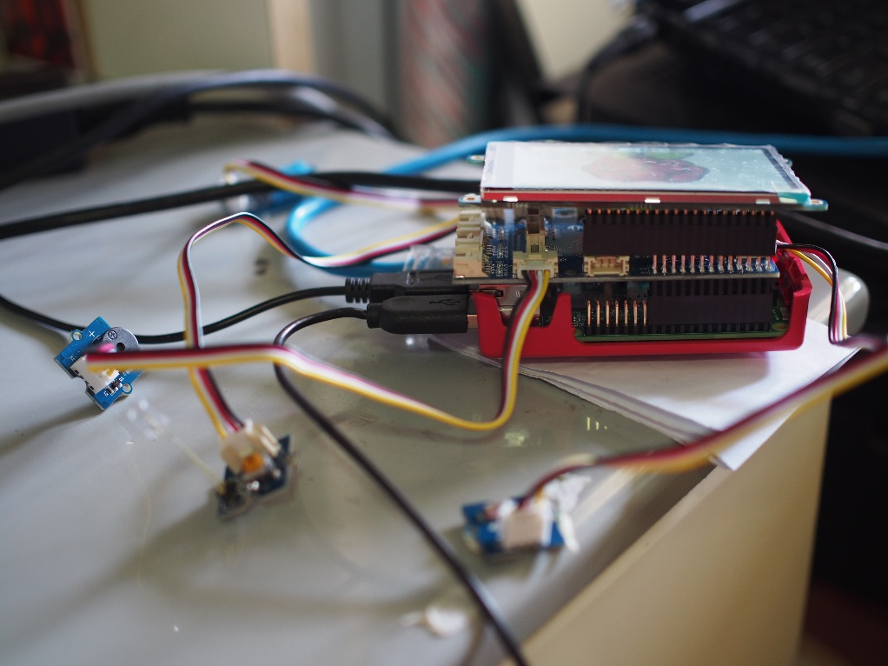
Hardware setup:

Slide 10
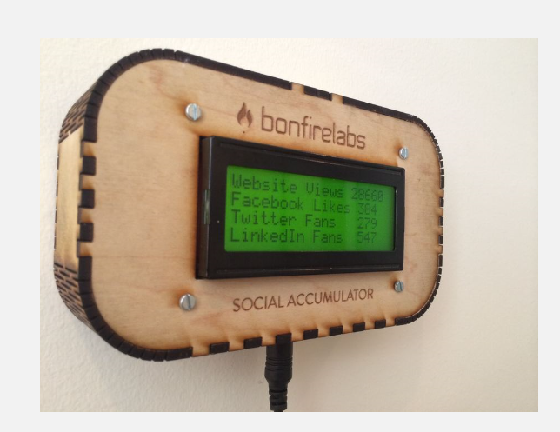
Another use case : Social accumulator
Highlight of social influence of your brand /company
It can be another useful info like bus arrival time / air quality info etc
There is market for this kind of device in Singapore; to make IoT seamless

Slide 11
DEMO
Please visit this YouTube link for demo video - https://youtu.be/2RyU7oBz02I

Slide 12

Data collection: Any monetary value ?
FB Likes, Temperature and Light uploaded to AWS, Sumo Logic, Slack with time stamp
Facebook itself has very useful analysis tool ( so no need to spend on sumo logic etc)
Industry source shows Facebook Likes has monetary values

Slide 13
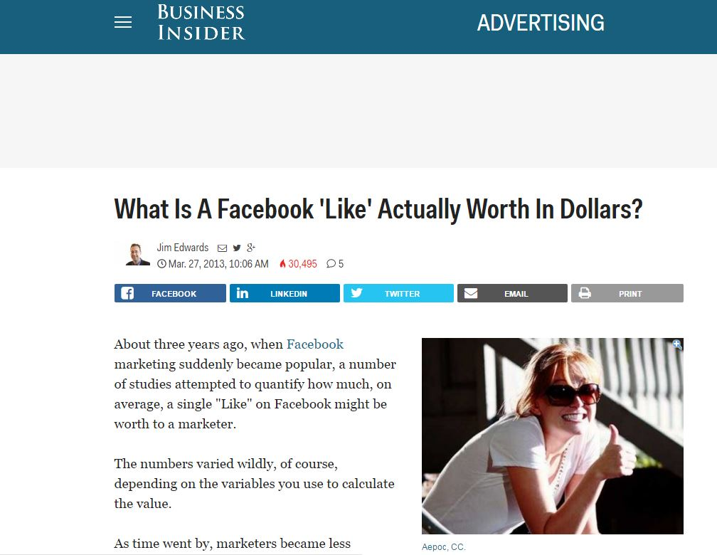
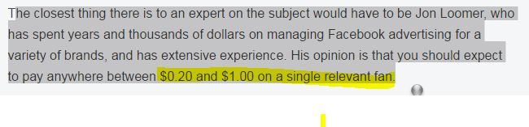

Slide 14
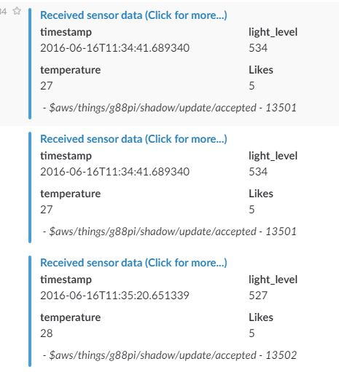

Slide 15
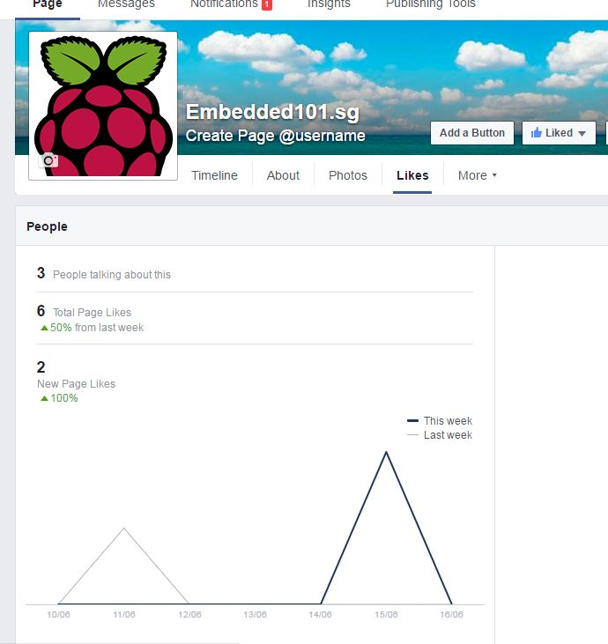
FB Insights

Slide 16
Q and A
Thank you – Likes us ☺

